Slide 1



Apr 30th, 2018

Slide 2
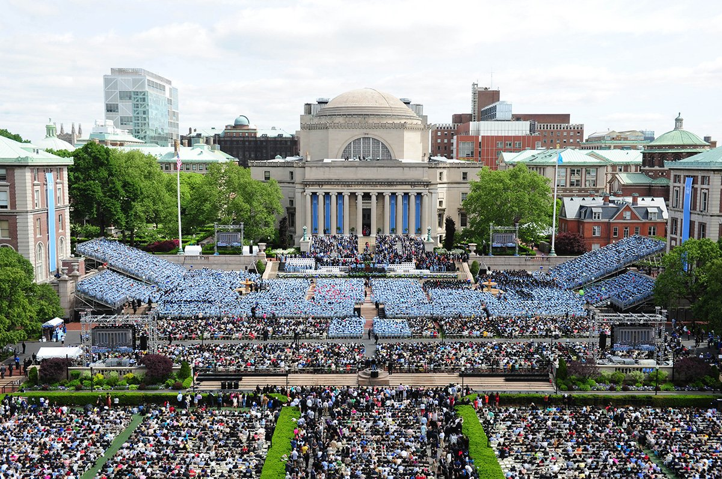







Blue Cloud Ventures requires an automatic process to prioritize which companies they should reach out to
Currently, the process to select which companies should be approached consist of manual processes. This could be improved by implementing a standardized method
We started with more than 50K listings for NYC and decided to focus on 3 neighborhoods
After that, we made an analysis and built our models with 5,296 datapoints corresponding to rooms available from AirBNB data, however, some of them are not longer available
When we incorporated Ratings Analysis, we found data points for 3,666 of them and performed a new analysis of them
Additionally, we performed sentiment analysis, price correlation, reviews correlation among other analysis
Finally, we built an interactive dashboard to help with the decision
Notes:
Understand the process to find the investing companies is done manually. It is manually done, they don’t have the right criteria, they can have missed opportunities.
Possible solution
Have an automatic process based on selected criteria that can be automatically updated in order to enhance the selecetion process and giving them the time to focus on what matters, building the relation.
There is no database or control group
Prioritization of clients for reaching them

Slide 3


After reviewing the original data, we found that potential relevant data was missing and we decided to gather it
We built a scraper for AirBNB and used it on the 5000+ data points corresponding to the 3 neighbourhoods analyzed
Room | Stars | Accuracy | Communication | Cleanliness | Location | Check-In | Value
5203 | 5 | 10 | 10 | 10 | 10 | 10 | 10
5295 | 4.5 | 10 | 10 | 9 | 9 | 10 | 9
6021 | 4.5 | 9 | 10 | 10 | 9 | 10 | 9
9668 | 4.5 | 9 | 9 | 7 | 9 | 9 | 9
9704 | 5 | 10 | 10 | 9 | 10 | 10 | 10
…
We obtained the Rankings across 6 different categories as well as the overall Ranking (Stars)
Room | Review 1 | Review 2 | Review 3 | Review 4 | Review 5 | Review 6 | Review 7 | Description
5203 | "fantastic. great stay and nice people " | "Great location, 5min walk to Columbia campus;... | "Great price for the room and location. My hos... | "Welcoming space, clean, great location, comfo... | "Hands down my favorite Airbnb listing where I... | "MaryEllen is a very nice, hospitable person. ... | "The whole family is amazing, including their ... | sectioned_description":{"access":"Guests will ...
5295 | "Great option for a trip to NYC!!!!! Quick res... | "The host canceled this reservation 14 days be... | "Great place. Great location \nSuper Host. \n... | "This a perfect place! Perfect location (Uppe... | "Lena is a very thoughtful and attentive host.... | "Great location." | "Lena was a terrific host, and her apartment i... | sectioned_description":{"access":null,"author_...
6021 | "I would first like to start by saying that Cl... | "My stay was beyond pleasant! Claudio has a be... | "Claudio’s place was great. Only 2 short block... | "This is one of the best Airbnb apartment I’ve... | "This is an amazing location - across the stre... | "The reservation was canceled 7 days before ar... | "Claudio's apartment was a great find! It is c... | sectioned_description":{"access":"Guests are w...
9668 | "This is probably one of the best places to st... | "We met Donaldo and he was very sweet and prov... | "I didn't meet Trip, but his co-host managed e... | "Big applauds to a co-host Donald. He was very... | "pretty comfortable place and accessible to an... | "I’ll begin by saying, “you get what you pay f... | "Trip was very flexible and accommodating!" | sectioned_description":{"access":"bedroom, bat...
…
We took the latest 7 reviews for each of the rooms as they are the most representative
We also obtained the Description of the Listing
With these features we were able to perform additional analysis
Notes:
Understand the process to find the investing companies is done manually. It is manually done, they don’t have the right criteria, they can have missed opportunities.
Possible solution
Have an automatic process based on selected criteria that can be automatically updated in order to enhance the selecetion process and giving them the time to focus on what matters, building the relation.
There is no database or control group
Prioritization of clients for reaching them

Slide 4
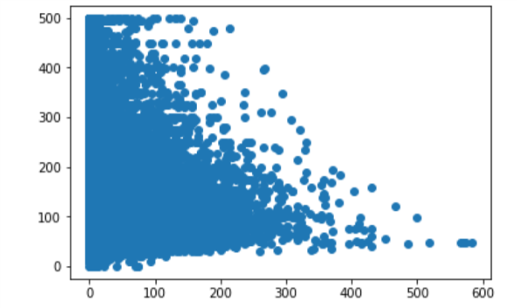
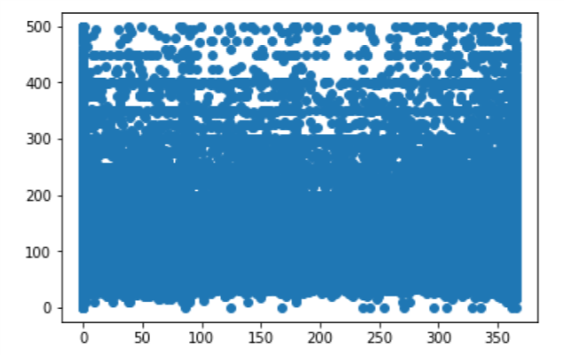
Blue Cloud Ventures requires an automatic process to prioritize which companies they should reach out to
Currently, the process to select which companies should be approached consist of manual processes. This could be improved by implementing a standardized method
After this analysis, we can see that the number of reviews doesn't explain the price. We can drop this feature, it
is useless for our model
We conclude that availability is not an explanatory feature for the price
Notes:
Understand the process to find the investing companies is done manually. It is manually done, they don’t have the right criteria, they can have missed opportunities.
Possible solution
Have an automatic process based on selected criteria that can be automatically updated in order to enhance the selecetion process and giving them the time to focus on what matters, building the relation.
There is no database or control group
Prioritization of clients for reaching them

Slide 5
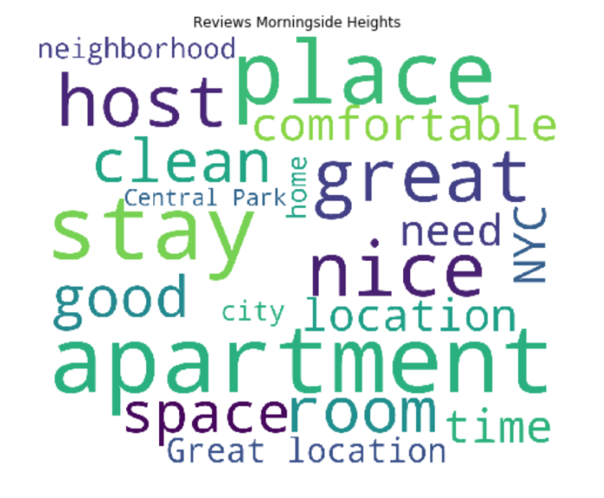
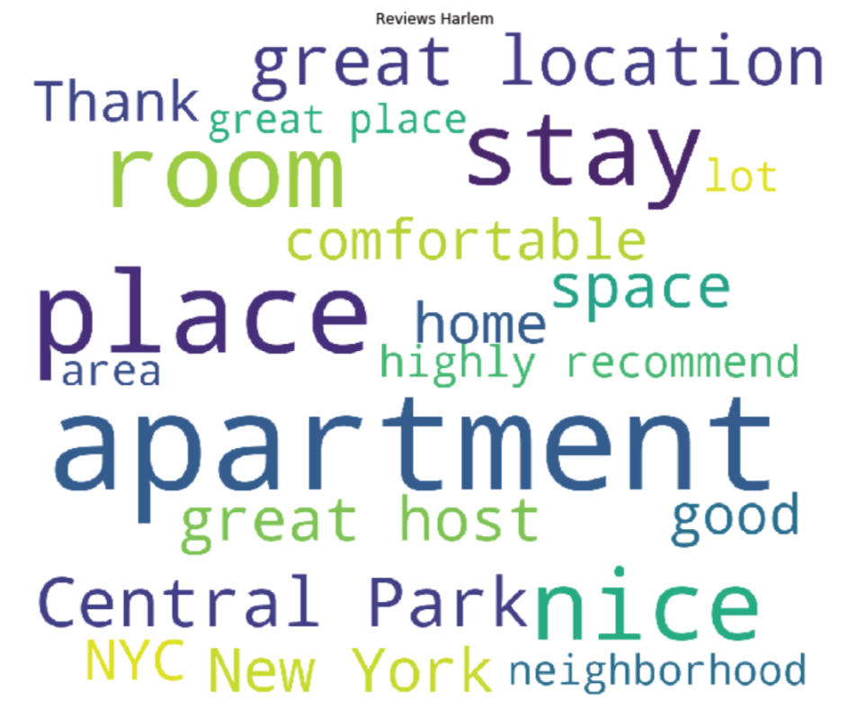
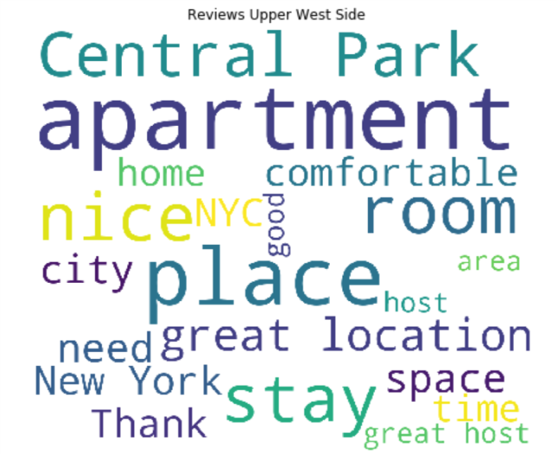
We performed Sentiment analysis in order to obtain an additional point of comparison for our friends and family
After performing sentiment analysis on the 3 neighbourhoods we concluded that they have virtually the same perception
Positive | Negative | Neutral | Compound
26% | 2% | 72% | 40%
Positive | Negative | Neutral | Compound
27% | 2% | 71% | 41%
Positive | Negative | Neutral | Compound
27% | 2% | 71% | 41%
Given this similarity, the decision should depend on other factors such as room features, price, location, etc.
Notes:
Understand the process to find the investing companies is done manually. It is manually done, they don’t have the right criteria, they can have missed opportunities.
Possible solution
Have an automatic process based on selected criteria that can be automatically updated in order to enhance the selecetion process and giving them the time to focus on what matters, building the relation.
There is no database or control group
Prioritization of clients for reaching them

Slide 6
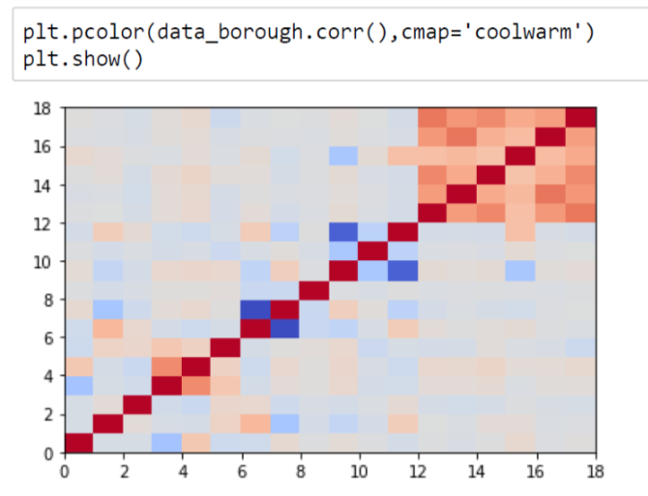
Blue Cloud Ventures requires an automatic process to prioritize which companies they should reach out to
Currently, the process to select which companies should be approached consist of manual processes. This could be improved by implementing a standardized method
#First, we try to suppress some features to reduce overfitting
del data_borough['Value']
del data_borough['Cleanliness']
del data_borough['Check-In']
The results are slightly better than for the previous model without outliers. It is not very surprising since
the price and the ratings were barely correlated. We verify that the ratings are not very explanatory of the
price.
Notes:
Understand the process to find the investing companies is done manually. It is manually done, they don’t have the right criteria, they can have missed opportunities.
Possible solution
Have an automatic process based on selected criteria that can be automatically updated in order to enhance the selecetion process and giving them the time to focus on what matters, building the relation.
There is no database or control group
Prioritization of clients for reaching them

Slide 7
Blue Cloud Ventures requires an automatic process to prioritize which companies they should reach out to
Currently, the process to select which companies should be approached consist of manual processes. This could be improved by implementing a standardized method
Notes:
Understand the process to find the investing companies is done manually. It is manually done, they don’t have the right criteria, they can have missed opportunities.
Possible solution
Have an automatic process based on selected criteria that can be automatically updated in order to enhance the selecetion process and giving them the time to focus on what matters, building the relation.
There is no database or control group
Prioritization of clients for reaching them

Slide 8

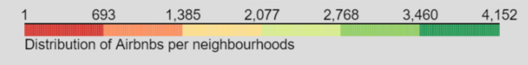
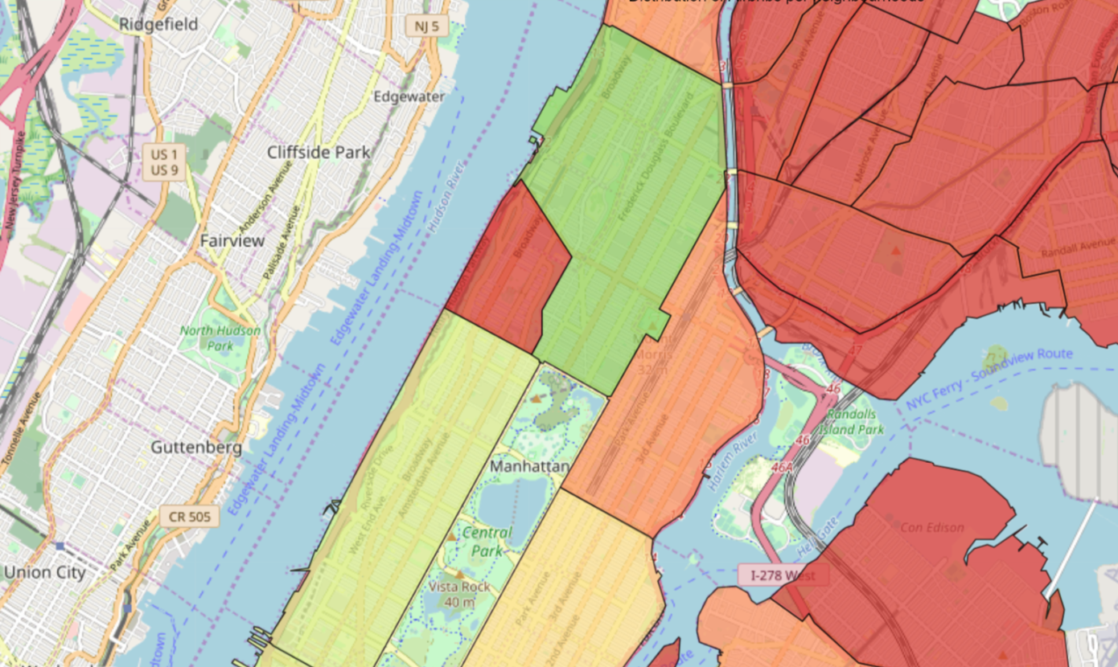
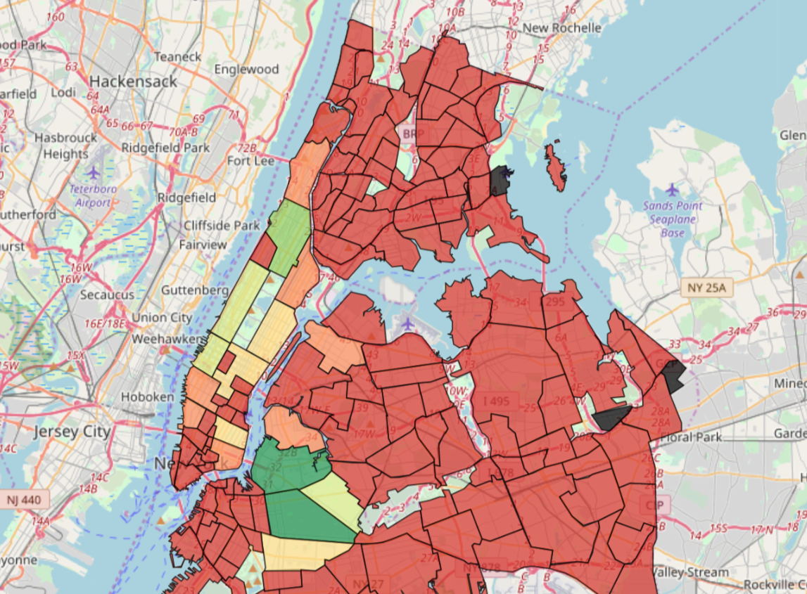

Blue Cloud Ventures requires an automatic process to prioritize which companies they should reach out to
The
Distribution of Listings
Harlem has the most listings available and Morningside shows a very limited amount of them, both due to its size and the “student” nature of the neighborhood
Notes:
Understand the process to find the investing companies is done manually. It is manually done, they don’t have the right criteria, they can have missed opportunities.
Possible solution
Have an automatic process based on selected criteria that can be automatically updated in order to enhance the selecetion process and giving them the time to focus on what matters, building the relation.
There is no database or control group
Prioritization of clients for reaching them

Slide 9

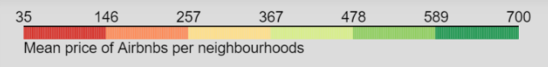
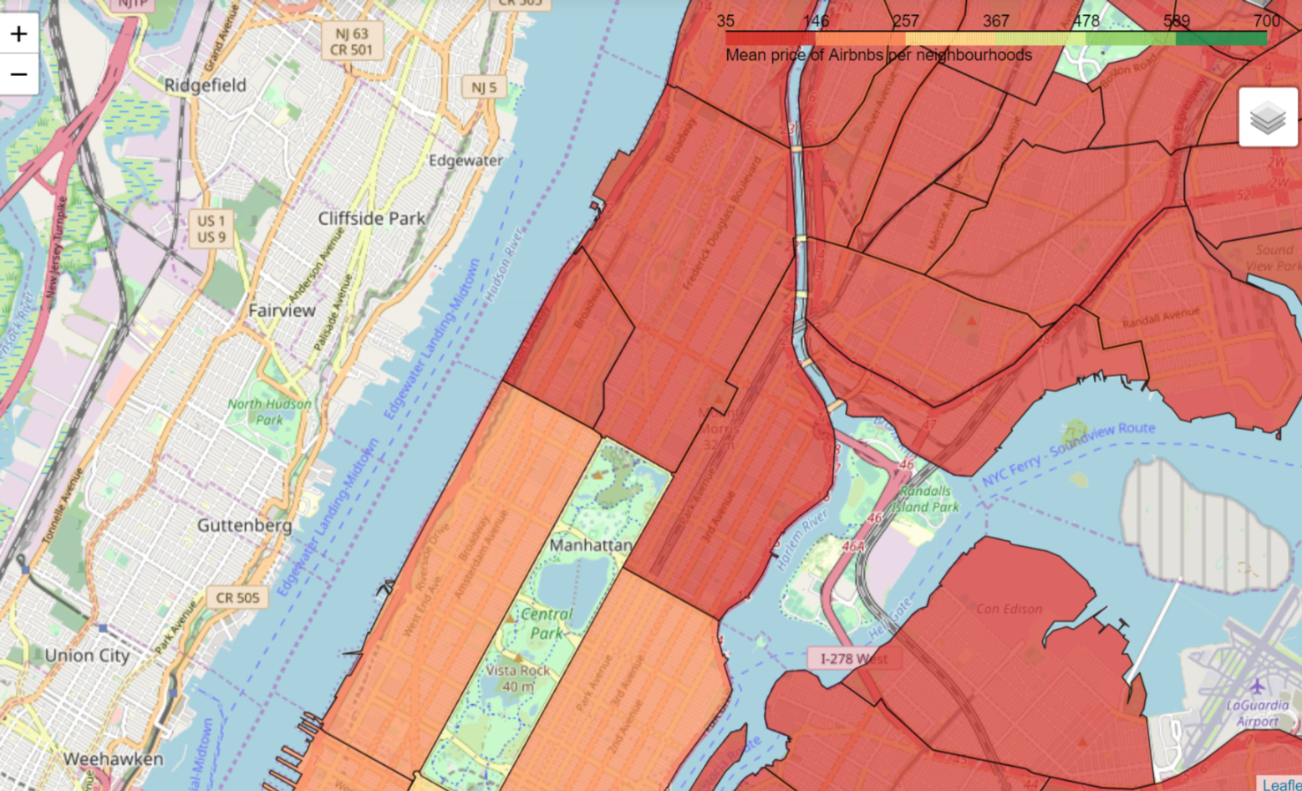
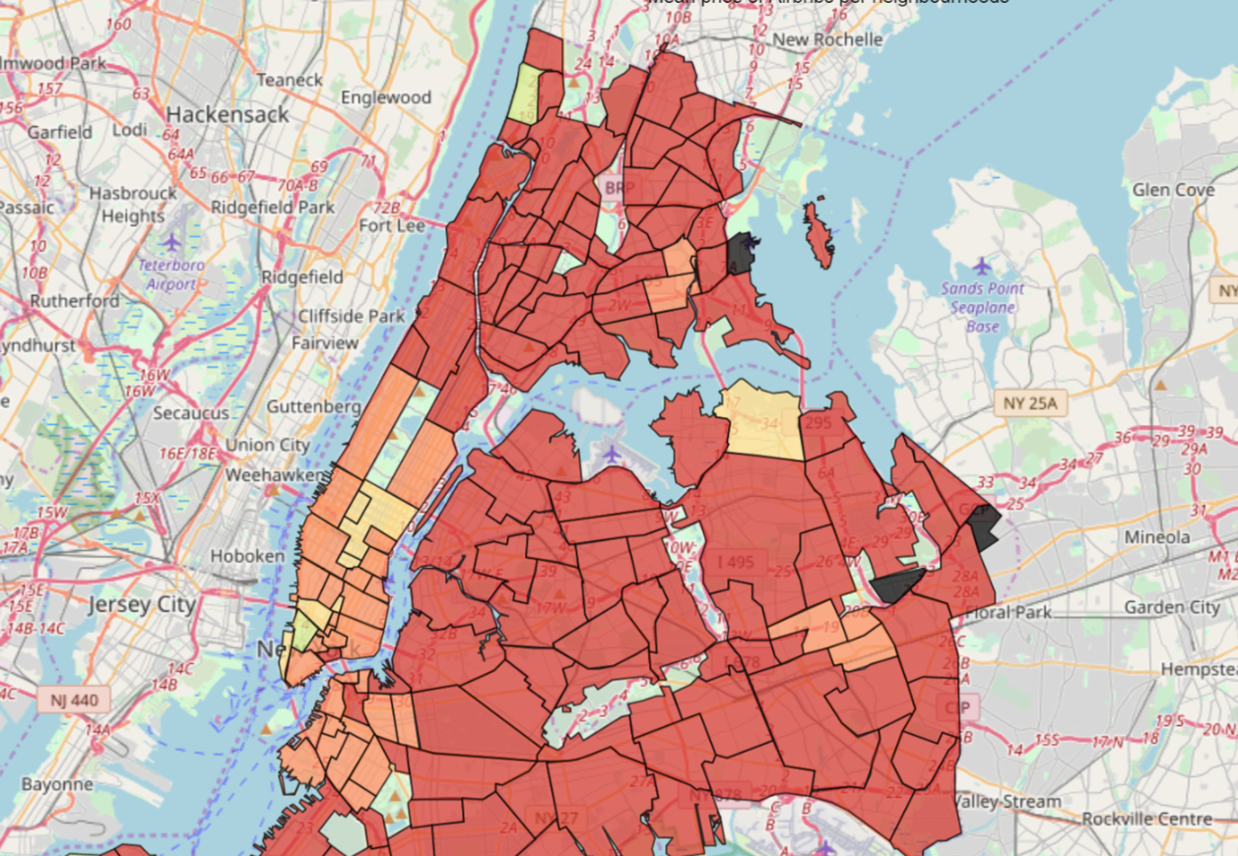
Blue Cloud Ventures requires an automatic process to prioritize which companies they should reach out to
A
Mean Price
We can observe than in average, UWS has slighter higher prices than the other 2 analyzed neighborhoods, this is expected as it is closer to midtown
Notes:
Understand the process to find the investing companies is done manually. It is manually done, they don’t have the right criteria, they can have missed opportunities.
Possible solution
Have an automatic process based on selected criteria that can be automatically updated in order to enhance the selecetion process and giving them the time to focus on what matters, building the relation.
There is no database or control group
Prioritization of clients for reaching them

Slide 10
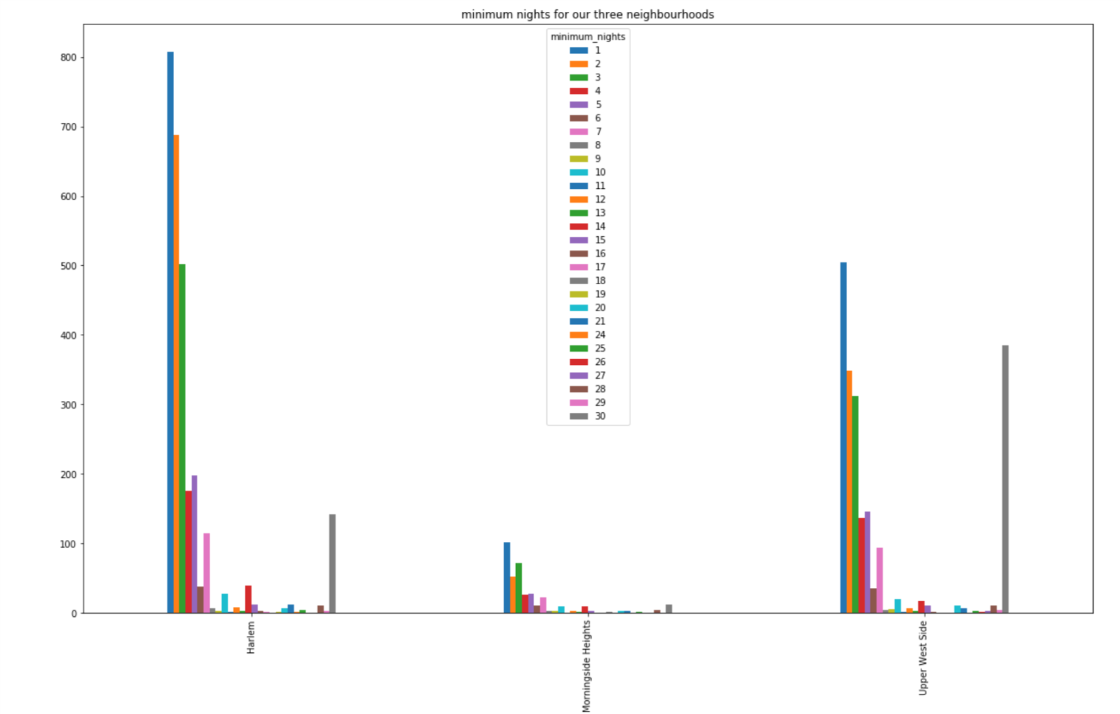
Blue Cloud Ventures requires an automatic process to prioritize which companies they should reach out to
Currently, the process to select which companies should be approached consist of manual processes. This could be improved by implementing a standardized method
Notes:
Understand the process to find the investing companies is done manually. It is manually done, they don’t have the right criteria, they can have missed opportunities.
Possible solution
Have an automatic process based on selected criteria that can be automatically updated in order to enhance the selecetion process and giving them the time to focus on what matters, building the relation.
There is no database or control group
Prioritization of clients for reaching them

Slide 11
Blue Cloud Ventures requires an automatic process to prioritize which companies they should reach out to
Currently, the process to select which companies should be approached consist of manual processes. This could be improved by implementing a standardized method
Conclusions
Notes:
Understand the process to find the investing companies is done manually. It is manually done, they don’t have the right criteria, they can have missed opportunities.
Possible solution
Have an automatic process based on selected criteria that can be automatically updated in order to enhance the selecetion process and giving them the time to focus on what matters, building the relation.
There is no database or control group
Prioritization of clients for reaching them

Slide 12






In summary, we analysed and built several models to understand better the dynamics of AirBNB in NY
We focused on the 3 closest neighbourhoods to Columbia University to offer an option to friends and family attending commencement
The following are the main conclusions on the various analysis performed:
Manhattan is a very peculiar area in which prices are not exactly correlated to Ratings.
The High Demand experienced all-year round in almost every “central” neighbourhood might be one of the main reasons for this
The amount of reviews and its consistency is one of the few available features that can help with a decision
All 3 Target Neighbourhouds share virtually the same perception based on the available reviews, therefore this is not a relevant decision maker in this particular situation
Reviews
Sentiment Analysis
AirBNB appears to be a self-discriminating platform. We can conclude this from the listings available, the reviews are in general very good which might be an indicator of bad hosts and their listings dropping out of the platform
Price depends on the facilities and the services offered and not on reviews or location in this particular case
Morningside Heights has the less amount of options, followed by UWS. Harlem has the most available listings
Price
Neighbourhood
We decided to build an interactive Dashboard to help in the selection of the best experience
Notes:
Understand the process to find the investing companies is done manually. It is manually done, they don’t have the right criteria, they can have missed opportunities.
Possible solution
Have an automatic process based on selected criteria that can be automatically updated in order to enhance the selecetion process and giving them the time to focus on what matters, building the relation.
There is no database or control group
Prioritization of clients for reaching them

Slide 13
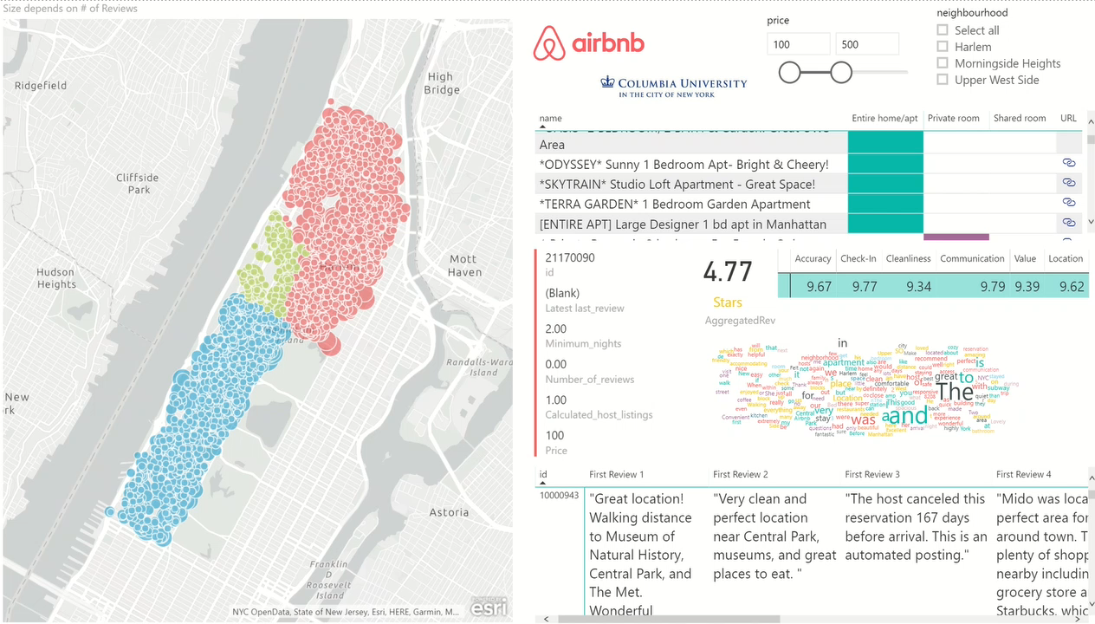
Blue Cloud Ventures requires an automatic process to prioritize which companies they should reach out to
Currently, the process to select which companies should be approached consist of manual processes. This could be improved by implementing a standardized method
URL for Dashboard (Map will not show in Web due to License Issues, but is available in original PowerBI file)
https://app.powerbi.com/view?r=eyJrIjoiMzE0OTc4ZDEtZTE0ZC00NWU1LWIyYmYtMDk1NDAxNmQyN2QyIiwidCI6IjA2ZDdlNTFiLTU4M2MtNDA4ZC05ZDY3LTQyNzI3YzcwM2NlNCIsImMiOjR9
Notes:
Understand the process to find the investing companies is done manually. It is manually done, they don’t have the right criteria, they can have missed opportunities.
Possible solution
Have an automatic process based on selected criteria that can be automatically updated in order to enhance the selecetion process and giving them the time to focus on what matters, building the relation.
There is no database or control group
Prioritization of clients for reaching them

Slide 14
Thank You

Slide 15




Blue Cloud Ventures requires an automatic process to prioritize which companies they should reach out to
Currently, the process to select which companies should be approached consist of manual processes. This could be improved by implementing a standardized method
Iterative
Assessment
Development and Implementation
Current Process
Variable
Selection
Model Proposal
Data Collection
Model Building
Maintenance & Refinement
Data collection via Pitchbook
Manual shortlisting based on qualitative and experiential assessment
Loss of potential investment due to absence of a revisit tool
Identify variables and sources based on availability and reliability
Add/delete variables based on team assessment and client input
Create compound variables with greater explanatory power
A model based on selected variables
Explore options to choose a model that best satisfies our objective
Use selected tools to extract and aggregate the data
Clean the data by removing duplicates, missing values, etc.
Try to incorporate intangible, qualitative data into the model based on client inputs
Train and refine the model by using various analytical measures
Make data gathering and cleaning easier for the client
Continue refining the model based on client input
The objective is to create a model which will replace and expedite their current manual process of shortlisting prospective investments that meet their basic criteria
Notes:
Understand the process to find the investing companies is done manually. It is manually done, they don’t have the right criteria, they can have missed opportunities.
Possible solution
Have an automatic process based on selected criteria that can be automatically updated in order to enhance the selecetion process and giving them the time to focus on what matters, building the relation.
There is no database or control group
Prioritization of clients for reaching them

Slide 16



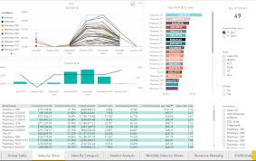
The variables extracted from the different websites will be used to build a model to rank potential companies
The proposed conceptual model will include a set of sub-models that will be weighted in order to get a general score output to form a ranking of the companies
Ranking Model
ILLUSTRATIVE
Weight: X%
Weight: X%
Weight: X%
Weight: X%
Weight: X%
Weight: 100%
100
Investor A
Investor B
-
-
-
Investor N
Replace with real model
Ideal Entry
Point
Rev
Emp
0-100
Geographic
Index
0
0←100→0
Convert to 0-100
0 100
Previous Investors Index
Growth Stage Index
KPIs
Additional Sub-Models
Composite Score formed by all Investors that have participated in previous rounds, data gathered from Pitchbook
Score to determine the attractiveness of investment based on the stage of the company
An analysis and incorporation of multiple KPIs will be made into several sub-models based on their availability and relevance
As many sub-models as needed will be incorporated into the main model, they can be KPIs, linear regressions, rankings, multilinear regressions, simulations, etc.
All sub-models will be scaled between 0-100, where 100 is ideal fit (based on industry standard, benchmarking, historic performance, SME recommendations, statistical model fit, or additional factors depending on each sub-model)
After determining which explanatory variables to include, we will procure the data using the various methods previously mentioned. Once aggregated we will clean the data by checking for invalid dates or observations, duplicates, missing values, etc. Finally we will train a linear model and use various analytical methods such as subset selection to refine it

Slide 17
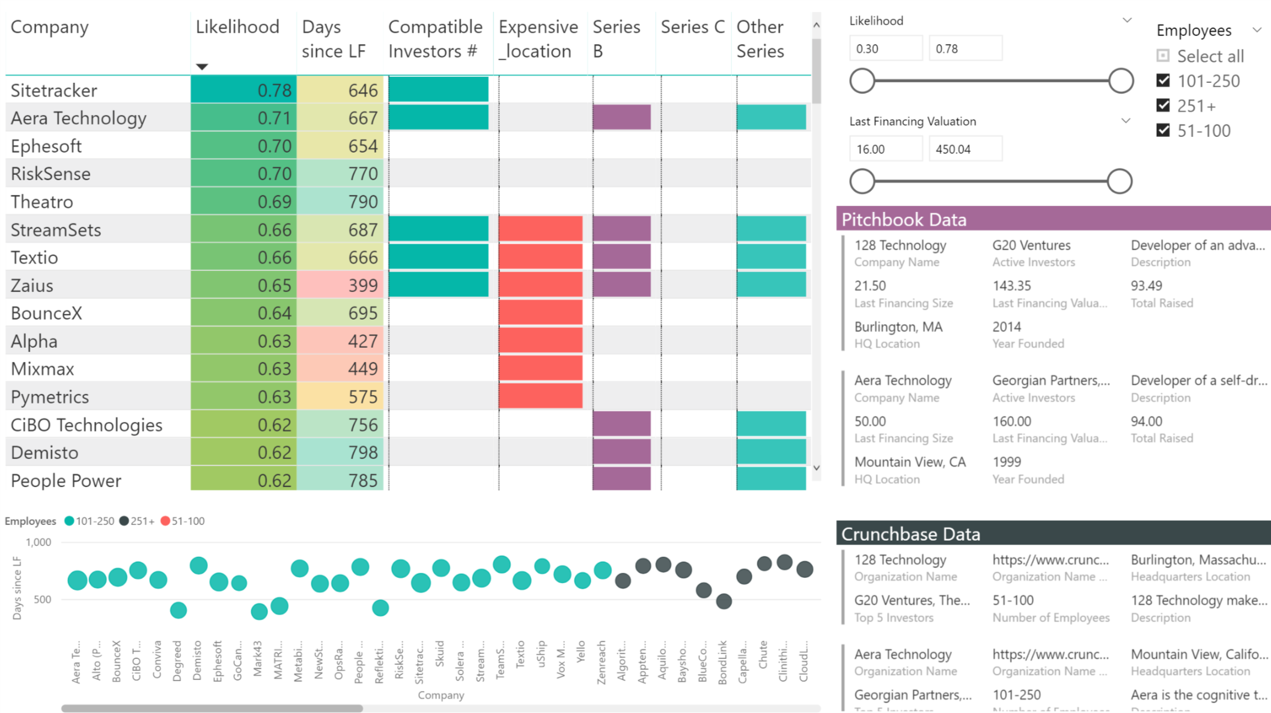






In order to analyze data in a more, pending description, enough text to fill 2 lines
NEW
A Dashboard was built to pending desc
Ranking Model Dashboard
The data generated by the model is fed to a Dashboard whit a ranking featuring the most significant attributes:
Likelihood: a company potentially being interesting as an investment opportunity
Days since last founding: more potential in a company without funding for some time
Investors: depending on previous investors, a company might be a closer match
Location: company location plays a role in the company dynamics and selection
Series: refers to the type of Funding Series, specifically B and C
# of employees: the size of the company plays a significant role in the ranking
By analyzing the data in this way, the team can easily identify Fill this with additional descriptions

Slide 18



Blue Cloud Ventures
Blue Cloud Ventures is a venture capital firm based in NYC that focuses on the SaaS sector. They invest during the growth stage after companies are making $10 million or more in revenue. In the last 6 years they have invested in 26 software companies
totoGEO
totoGeo is a project funded by the Bill and Melinda Gates Foundation in collaboration with INSEAD experts, using automated algorithmic authoring. totoGEO aims to produce and deliver educational content to as many people as possible by developing accurate translation methods which impact lesser known languages for which traditional methods are not available
IAS
IAS Corp is a Global Export Marketing Services company specialized in food retail. They have a portfolio of 50 US brands and 75 international importers in 58 overseas global markets. Their added value is in the adaptation of the American product to overseas market (regulation, labelling)

Slide 19
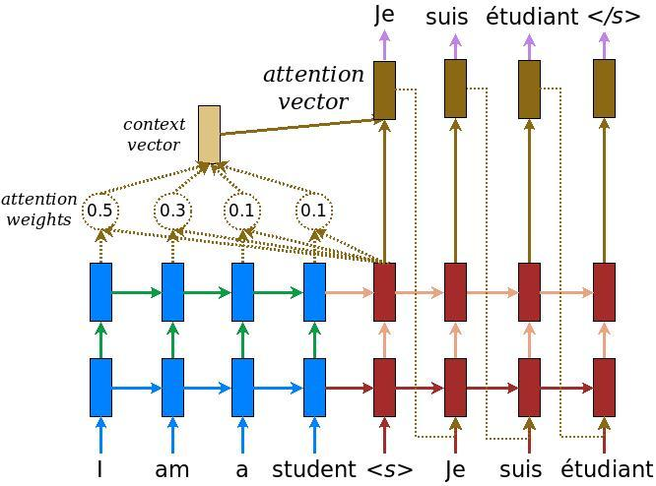

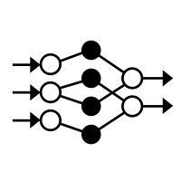


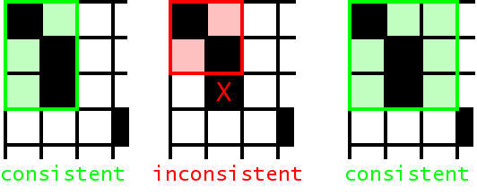

totoGEO project is focused on providing an opportunity to access knowledge to as many people as possible
The main objective is to apply and enhance Natural Language Translation by
Leveraging the use of Machine Learning and Graph Theory
Database Elaboration
Method Implementation
Data Collection
Data Cleaning and Formatting
Data Formatting
Test methods
Methods Evaluation
Establish an effective real-time robot
Small part of Totogeo’s data collection
New sources of data for forgotten languages-
Eliminate translation errors by identifying patterns
Account for context
Creation of better suited methods to create databases : - sentence-to- sentence translation - word-to-word translation
Glossary using graph theory
Implementation of existing algorithms, applied to NLT - statistical methods - neural networks
Evaluate methods on various criteria:
accuracy
computer power and time
training data volume
Illustrative
Optimize database form
Combine models and tune parameters
The whole process requires exploring and applying different techniques to generate a set of algorithms that both improve and optimize an output with a good accuracy and that can be extrapolated to different languages
Notes:
Understand the process to find the investing companies is done manually. It is manually done, they don’t have the right criteria, they can have missed opportunities.
Possible solution
Have an automatic process based on selected criteria that can be automatically updated in order to enhance the selecetion process and giving them the time to focus on what matters, building the relation.
There is no database or control group
Prioritization of clients for reaching them

Slide 20

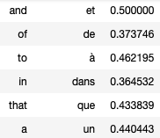

We are overcoming data scarcity by building glossaries and passing them through graphs algorithms
We subdivided the data in small and create a co-occurrence matrix of words that enables us to estimate the translation likelihood and from that to generate a glossary
Data subdivision
Translation likelihood
Data subdivision
Co-occurrence matrix
Glossaries creation
Subdivide data in chunks: using punctuations marks
Pre-processing
- Identifying the personal nouns and identical
- Words division and n-grams
For each pair of words, we estimate the translation likelihood
Basic score
EMIM score
Log likelihood score
Extracting pairs of words based on the combined translation score
Depuis, Bernard hurle« va au parking», en toutes circonstances.
Since then, Bernard screams “to the parking” in all circumstances.
- Most common words
- Most rare words
- Highest score
fr-en/en-fr
place back/not
French | depuis | hurle | va, au, va au
English | since, then, since then | screams | to, the, to the
Identicals |  | Bernard | parking
Combining co-occurence matrix on 150 sub datasets
Avoid memory error because of exponential sizes of the co-occurrence matrix before cleaning
Glossary based method: combining glossaries computed for each translation score
Score based method: combing score and compute one glossary
Co-occurrence matrix
With each chunks we incremente the co-occurrence of each French and English words
Cleaning chunks: - difference # words >10
- Long chunks > 15
French database :
Data : 40,000 rows Chunks : 170,000 rows
Cleaned : 135,000 rows
 | since then | since | … | in all circumstances
depuis | 1 | 1 | … | 0
… | … | … | … | …
circonstances | 0 | 0 | … | 1
These glosses can then be passed via graphs to boost core glosses (e.g. if we have a translation for the word beautiful, we can use that translation for "lovely" or "cute" or "gorgeous" etc.)
Cleaning the words with a total number of occurrences < 3 to avoid meaningless n-grams

Slide 21






Using enhanced data, we are building and comparing Statistical Translation Models to build an efficient model
SMT systems perform their task by breaking up source sentences into multiple chunks and then translate them phrase-by-phrase
Comparing models
SMT models
Training the pipeline
Decoder
Accuracy
BLEU score
NIST score
Leveinshtein distance and TER score
Computing resources
Space complexity
Time complexity
Training data volume
To build a model, we need to have texts with their properly translated versions mapped out
Jehovah’s Witness Parallel Corpus
European Parliament proceedings
The decoder’s job is to use the translation model to find the highest scoring sentence in the target language a given source sentence
The sentence is divided in chunks
We find all the translations possible for each chunks
The output is the combination with the highest likelihood score
Visualization of the model
The system infers matched translations by examining continuous sequences of words in the two language pairs
Models used
Rank
#2
Moses decoder GIZA ++
Phrasal
#3
#1
Decoder
Grammatical rules are added
Parallel texts
Highest probability of translation based off the co-occurrences

Slide 22



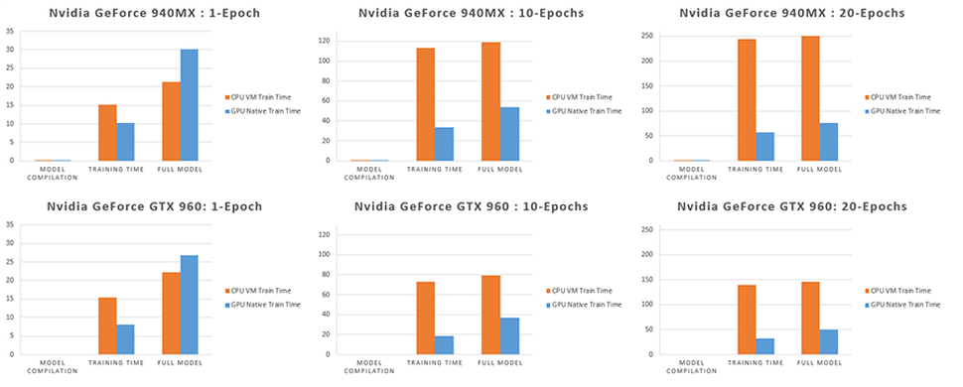

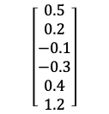
Neural Machine Translation reads the entire source sentence, ‘understands’ it and produces a translation
Sequence-to-sequence (seq2seq) models capture long-range dependencies in languages, e.g., gender agreements; syntax structures; etc., and produce much more fluent translations
Training the NMT Model
Inference – Generating translations
I am a student
Encoder
1st RNN
$$\left[\begin{aligned}0.5 \\ 0.2 \\ −0.1 \\ −0.3 \\ 0.4 \\ 1.2\end{aligned}\right]$$
Decoder
2nd RNN
Je suis étudiant
Memory of the previous words
Meaning vector
Memory of the previous words
The model targets embeddings to retrieve the corresponding word representations thanks to the encoder-decoder architecture.
Encoder
Decoder
read source sentence
build embedded vector
process embedded vector to emit a translation
The embedding weights, one set per language, are learned during training. Once retrieved, the word embeddings are fed as input into the main network, which consists of two multi-layer Recurrent Neural Networks.
The model then uses attention mechanism and greedy decoding to generate translation based on the most likely translation
Virtual Machine Build
On premise - cheaper in the long term - easier to access - best performance
Cloud - cheaper in the short term - unlimited resources
4 GPU

Slide 23
Blue Cloud Ventures
Blue Cloud Ventures is a venture capital firm based in NYC that focuses on the SaaS sector. They invest during the growth stage after companies are making $10 million or more in revenue. In the last 6 years they have invested in 26 software companies
totoGEO
totoGeo is a project funded by the Bill and Melinda Gates Foundation in collaboration with INSEAD experts, using automated algorithmic authoring. totoGEO aims to produce and deliver educational content to as many people as possible by developing accurate translation methods which impact lesser known languages for which traditional methods are not available
IAS
IAS Corp is a Global Export Marketing Services company specialized in food retail. They have a portfolio of 50 US brands and 75 international importers in 58 overseas global markets. Their added value is in the adaptation of the American product to overseas market (regulation, labelling)

Slide 24

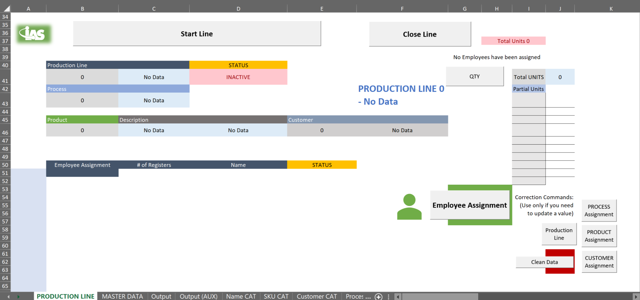




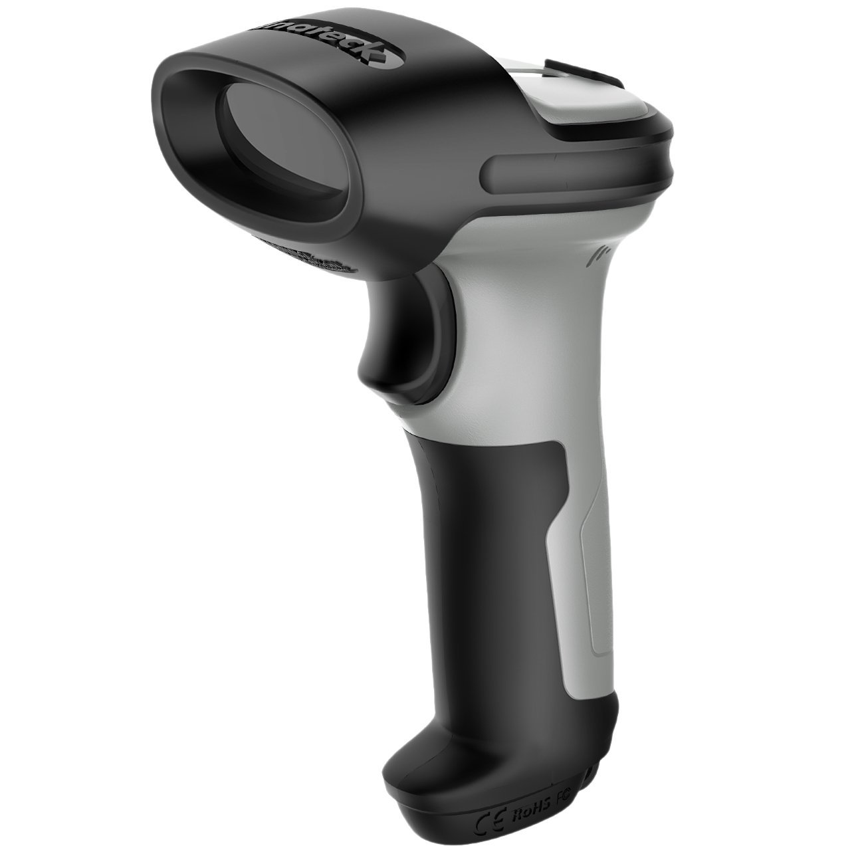



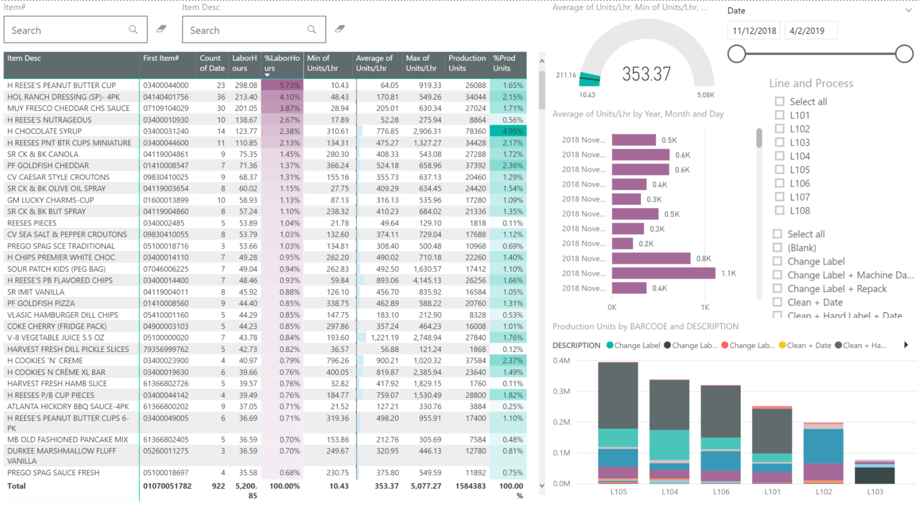
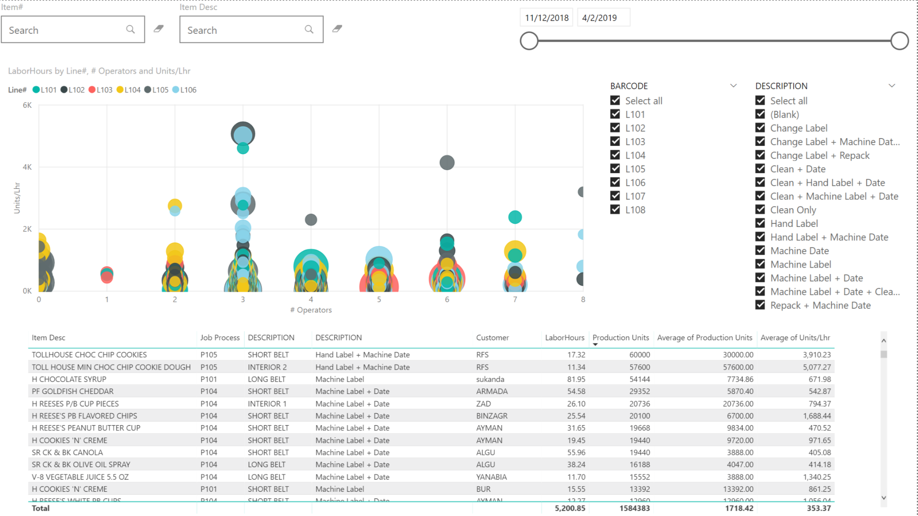

IAS main business model consists on processing finished products so that they comply with export regulations
Our
Value Proposition
Implementation
Relabeling / Labeling / Additional Printing
1
Data Collection (continuous process)
An Initial tool and methodology for collecting time and processing data across different categories was developed and is currently implemented. The gathered data is continuously being fed into a Dashboard which allows its deep analysis
Regulatory Conditions Handling
2
Data Analysis & Actions (continuous process)
Custom adaptation to destination market regulations and/or desired specifications
PENDING An Initial tool and methodology for collecting time and processing data across different categories was developed and is currently implemented. The gathered data will allow to start the full Cost Assignment process
Previous Situation
Current Situation
Quotations for product processing is made on previous experience, calculations and averages taken from different categories, not taking into account specific characteristics of each process
Better understanding and direct cost understanding based on real data. This helps the sales team to make accurate quotations and the production side to improve processes
PENDING By correctly assigning costs to each product, IAS will be able to prioritize client orders, pass on low margin opportunities and identify process improvement opportunities

Slide 25


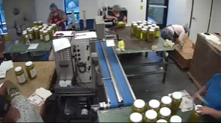



We developed a VBA tool for collecting data that has been implemented in the company’s production lines
Data is automatically inputted through a barcode scanner and processed automatically
1
Data Collection
The Productivity Template was implemented in Nov ‘18 and is still being used on a daily basis at the IAS warehouse to generate data
More than 900 full production runs have been collected to date
Master Productivity Template (.xlsm)
Macro Enabled Excel File used to register employees
Time Tool Template
P_Line_1_Productivity Template (.xlsm)
P_Line_2_Productivity Template (.xlsm)
Production Line Process
Every Production Line uses a Workbook to register each day’s production in a new workbook:
MM_DD_YY_PRODLINE#__HH_DD.xls
The output for each production line consists of a table containing the processed product as well as information regarding labor involved. This data is then used to analyze products with similar characteristics, establish benchmarks, identify issues and improve both productivity and sales
Table of automatically processed data with the production line details

Slide 26



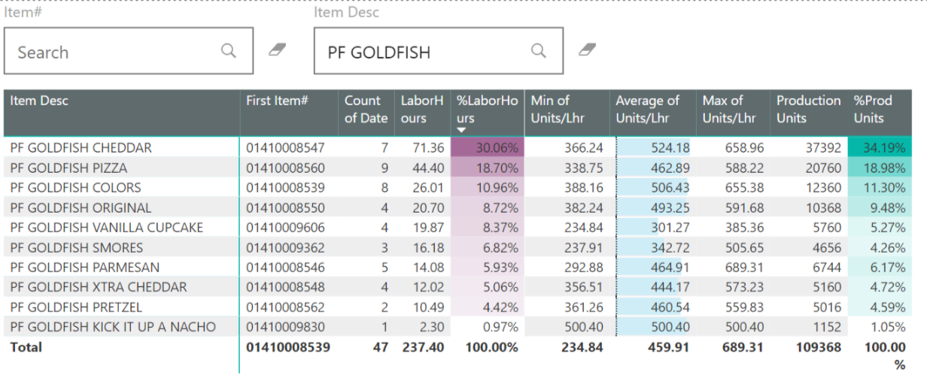
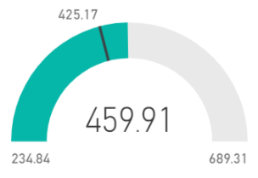




Pending
Pending
2
Data Analysis & Actions
Use Case (Pepperidge Farm)
47 data points to date (will keep increasing)
10 different SKUs but with similar characteristics
The collected data is used to feed a Dashboard, focusing on 3 main metrics:
Production Units
Labor Hours
Units / Labor Hours
Minimum production rate → 234.84 units / labor hours
Average production rate → 459.91 units / labor hours
Maximum production rate → 689.31 units / labor hours
Requires an update every time new data is collected, the process is as simple as replacing the old file for the updated one
By analyzing the data, the sales team can then decide to set up a reasonable, feasible quotation based on actual production runs
The production team can analyze production runs with low performance and take corrective actions
Depends only of 2 files: catalogs & output collection

Slide 27
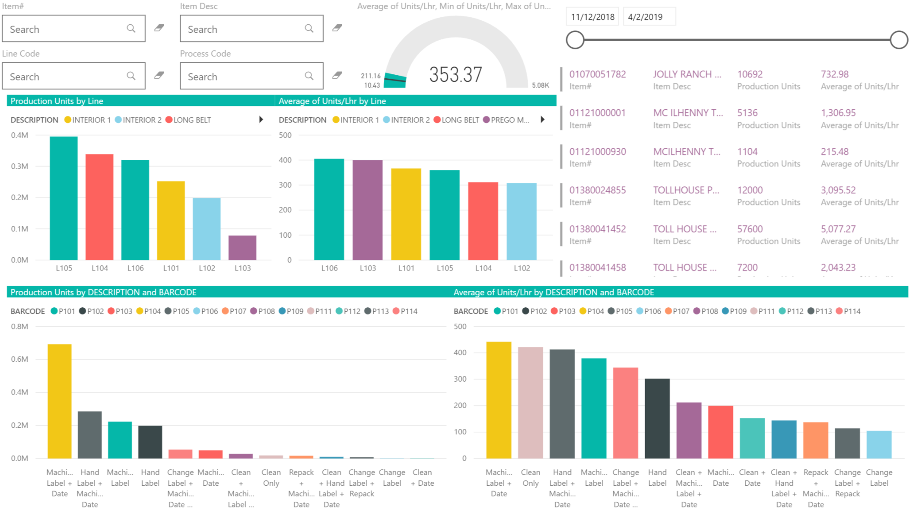
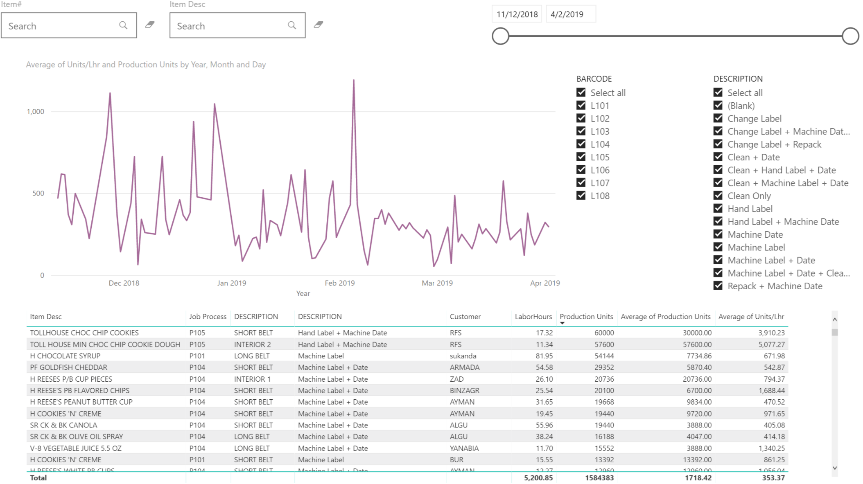






Pending
Pending
2
Data Analysis & Actions
Additional Dashboards allow a deep understanding of Line and Process, Productivity by Date and Production Run
Due to the nature of the processes, each production run has to be analyzed individually and quoted to potential clients accordingly, considering feasibility and potential margins
Main Benefits
Time and Resources Utilization
New Ideas Identification
Analysis & Issues Identification
KPI and Parameters Establishment
Target and Objectives Setting
Trends and Historical Data Utilization
PENDING By correctly assigning costs to each product, IAS will be able to prioritize client orders, pass on low margin opportunities and identify process improvement opportunities

